Slide 1
RACISM: THE EPIDEMIC BEHIND THE PANDEMIC
Michigan Health Policy Forum
September 14, 2020 at 1:00 pm.
ZOOM Conference

Slide 2
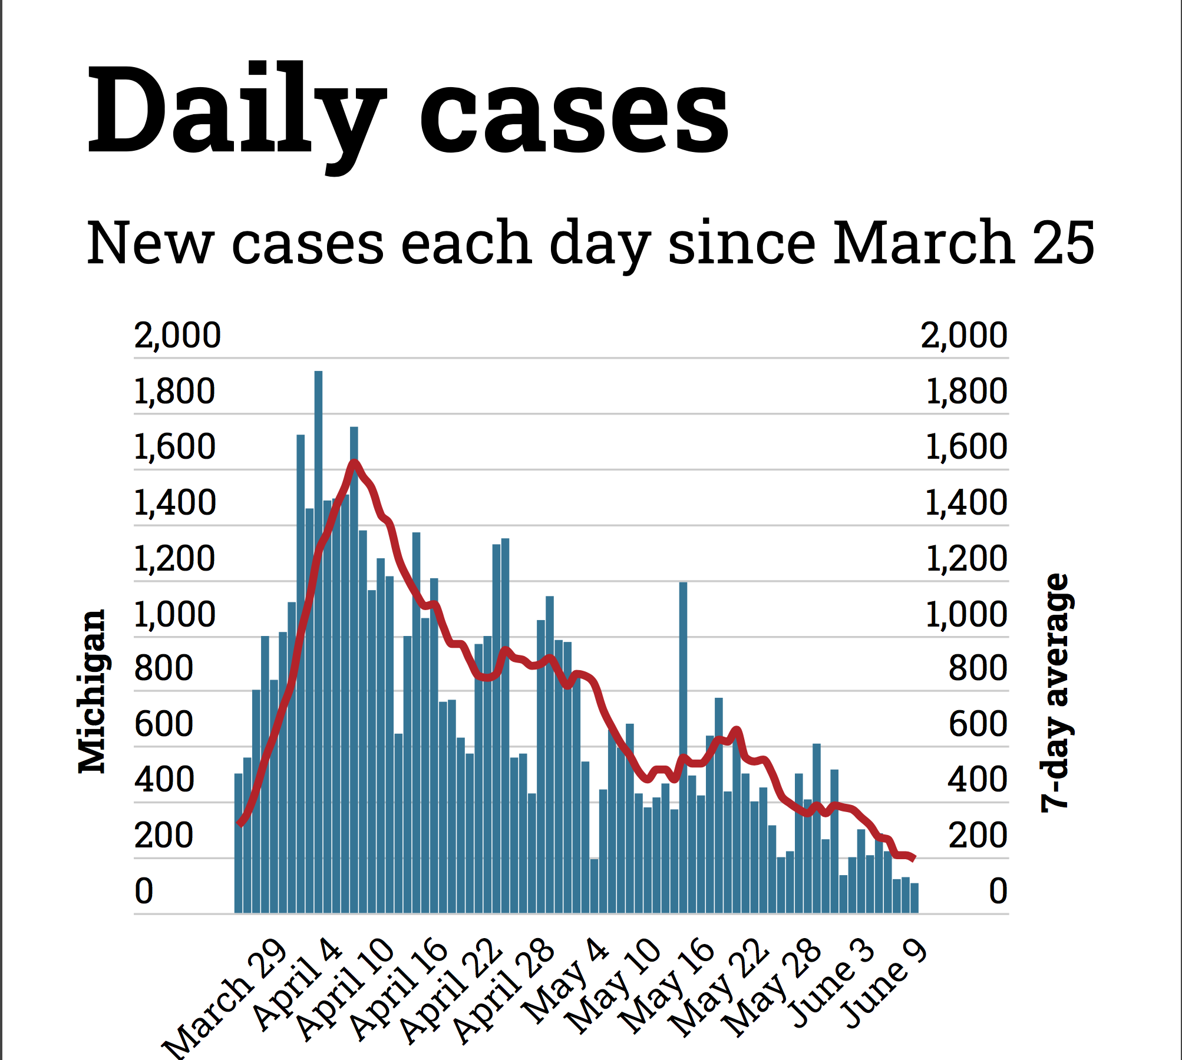

Slide 3
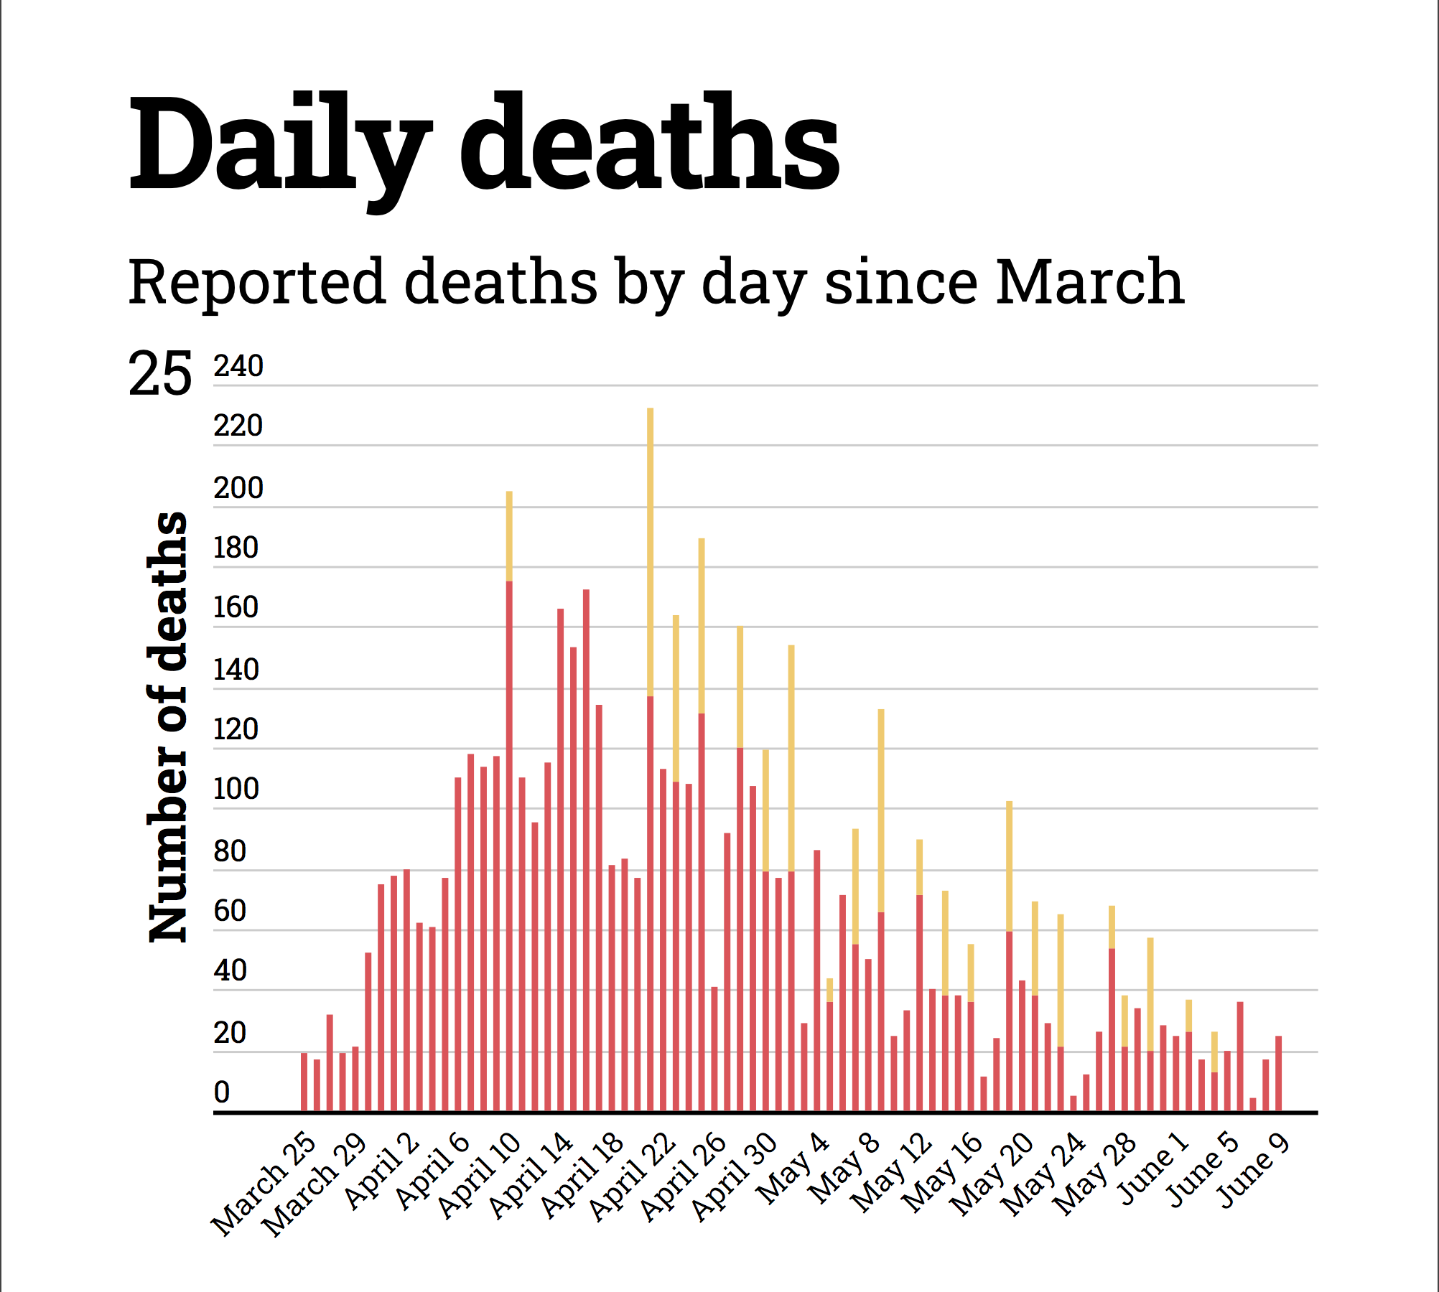

Slide 4

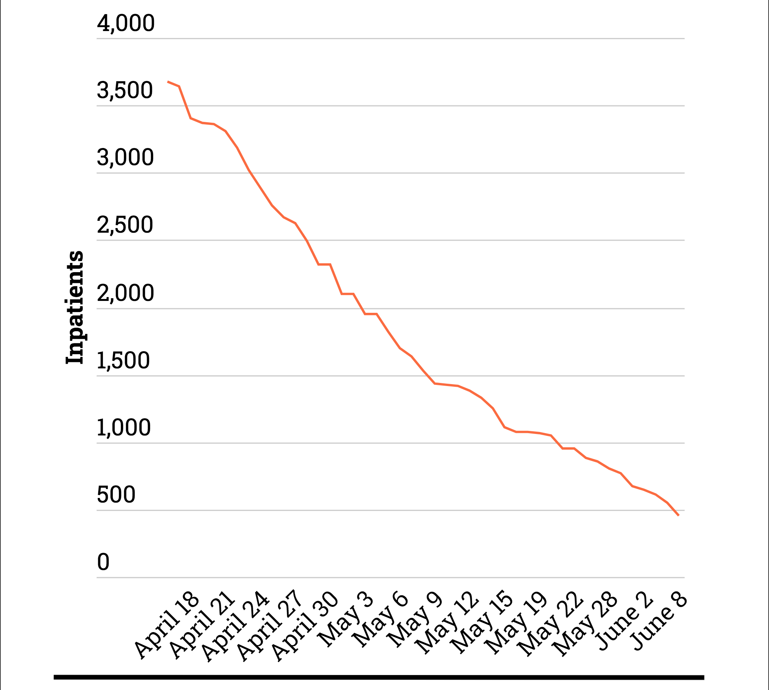


Slide 5
